Slide 1
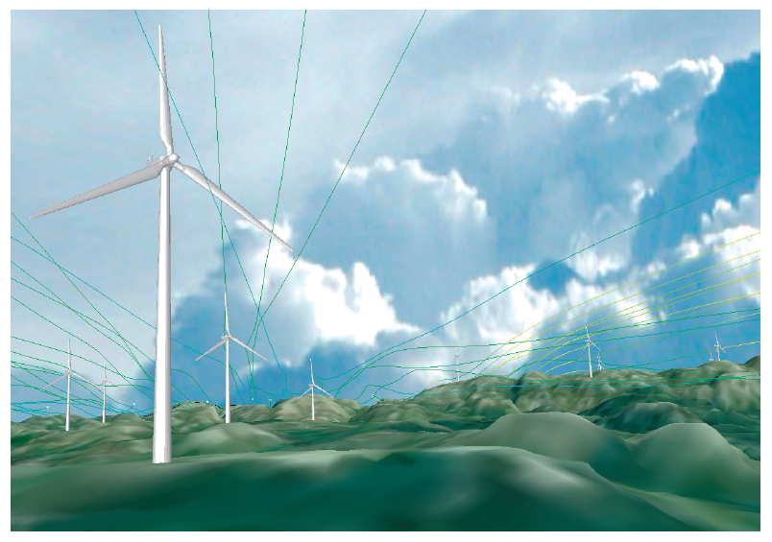
Wind Farms Design

Slide 2
Team members
1-Asmaa Safwat Mohamed Sec(1)
2-Hossam Hassan Ali Sec(2)
3-Hossam Taha Abdalslam Sec(2)
4-Hossam Hany Hemdan Sec(2)
5-Sara Mahmoud Hassan Sec(2)
6-Mohamed Magdy Sec()
Supervisor Dr:Sheren Mosa

Slide 3
Agenda
1) Introduction (A general introduction to the field of your project)
2) Problem Definition (the problem you are solving)
3) Objective (what you are aiming at)
4) Related Works (similar systems)
5) System Architecture (a diagram showing the basic modules of the system and how they interact)
6) SW Development Methodology
7) Functional Requirements.
8) System Analysis.
a)Use case diagram.
b)System Sequence Diagram.
9) Software & Hardware Tools.
10) Time Plan

Slide 4
Introduction
Our project take coordinates of location that user want to build turbines on it then check if this place suitable to build turbines or not based on algorithms that calculate wind energy in this place, direction of wind
based on this calculation we accept or reject this place
- if we accept it then we will distribute turbines
on map in this location and distance between them
- else user will change coordinates.

Slide 5
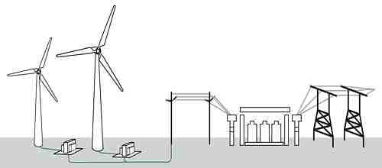
Objective(what you are aiming at)
we need to check suitable location or not based on wind speed , calculate power of turbine based on wind speed , calculate number of turbines based on distance of farm and establish distance between the turbines

Slide 6
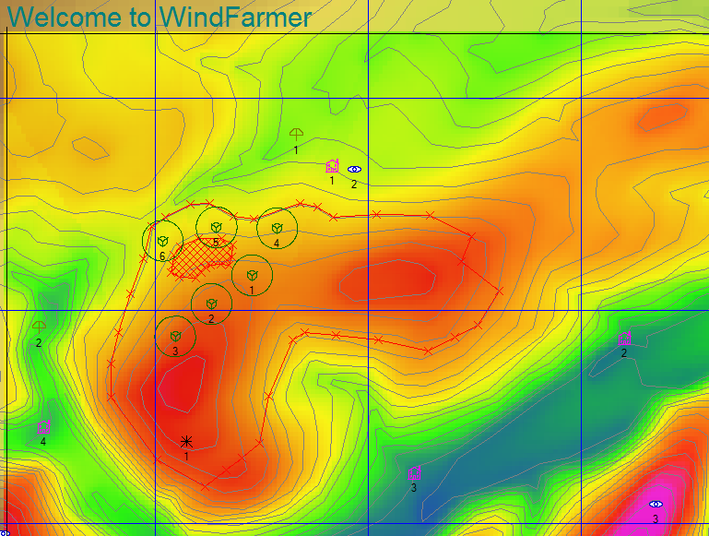
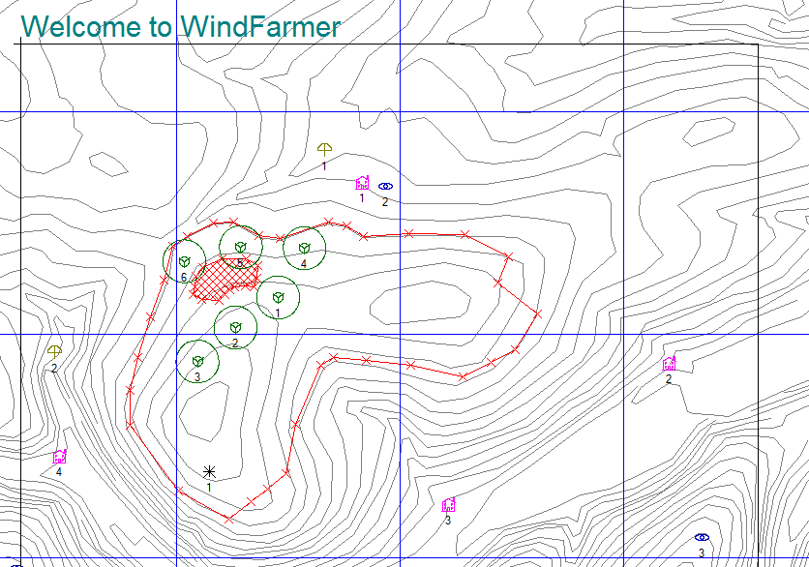
Related Works (similar systems)
Wind farmer system

Slide 7
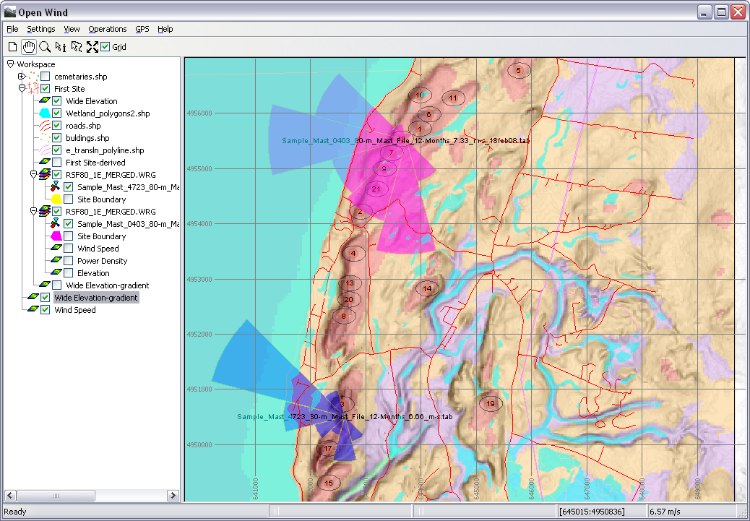
Continue..
Open wind software
(Open source )

Slide 8
SW Development Methodology

Slide 9

Problem Definition
problems of :
optimally find the suitable place for wind farm .
optimally positioning of the turbines to make
the expected power production maximized.
Notes:
**Problem Definition :-
**Problem Definition :-
-an important problem of optimally find the suitable place for wind farm .
solving using dataSet of wind and weather and using it in some algorithm we nw can find easly the best place to make wind farm .
- An important phase of a wind farm design is solving the problem of optimally positioning
of the turbines within the wind farm so that the wake effects are minimized and
therefore the expected power production maximized.
currently, this problem is usually solved using very simple rules that lead to
rectilinear layouts where turbines are often organized in identical rows that are
seperated by a convediently large distance.
- And the problem of design the turbines so that the turbines resist the disturbances
and large wind speed.
- An important phase of a wind farm design is solving the problem of optimally positioning
of the turbines within the wind farm so that the wake effects are minimized and
therefore the expected power production maximized.
currently, this problem is usually solved using very simple rules that lead to
rectilinear layouts where turbines are often organized in identical rows that are
seperated by a convediently large distance.
- And the problem of design the turbines so that the turbines resist the disturbances
and large wind speed.

Slide 10
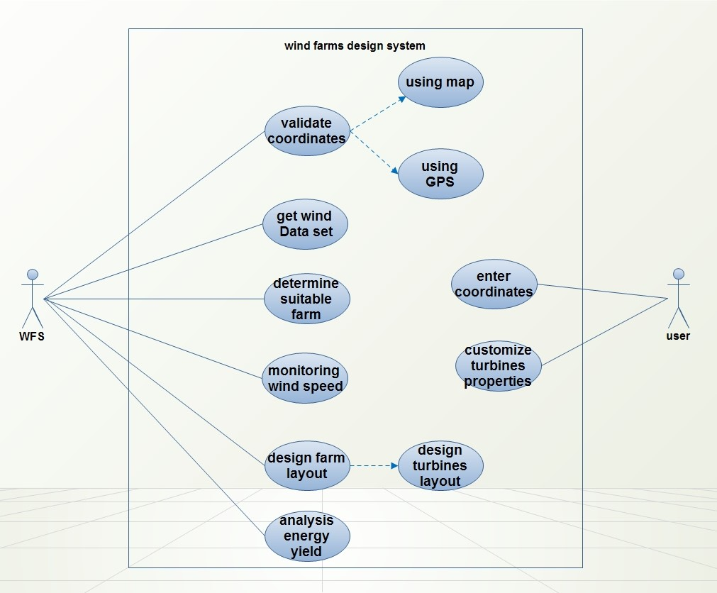
Wind Farms Design usecase

Slide 11
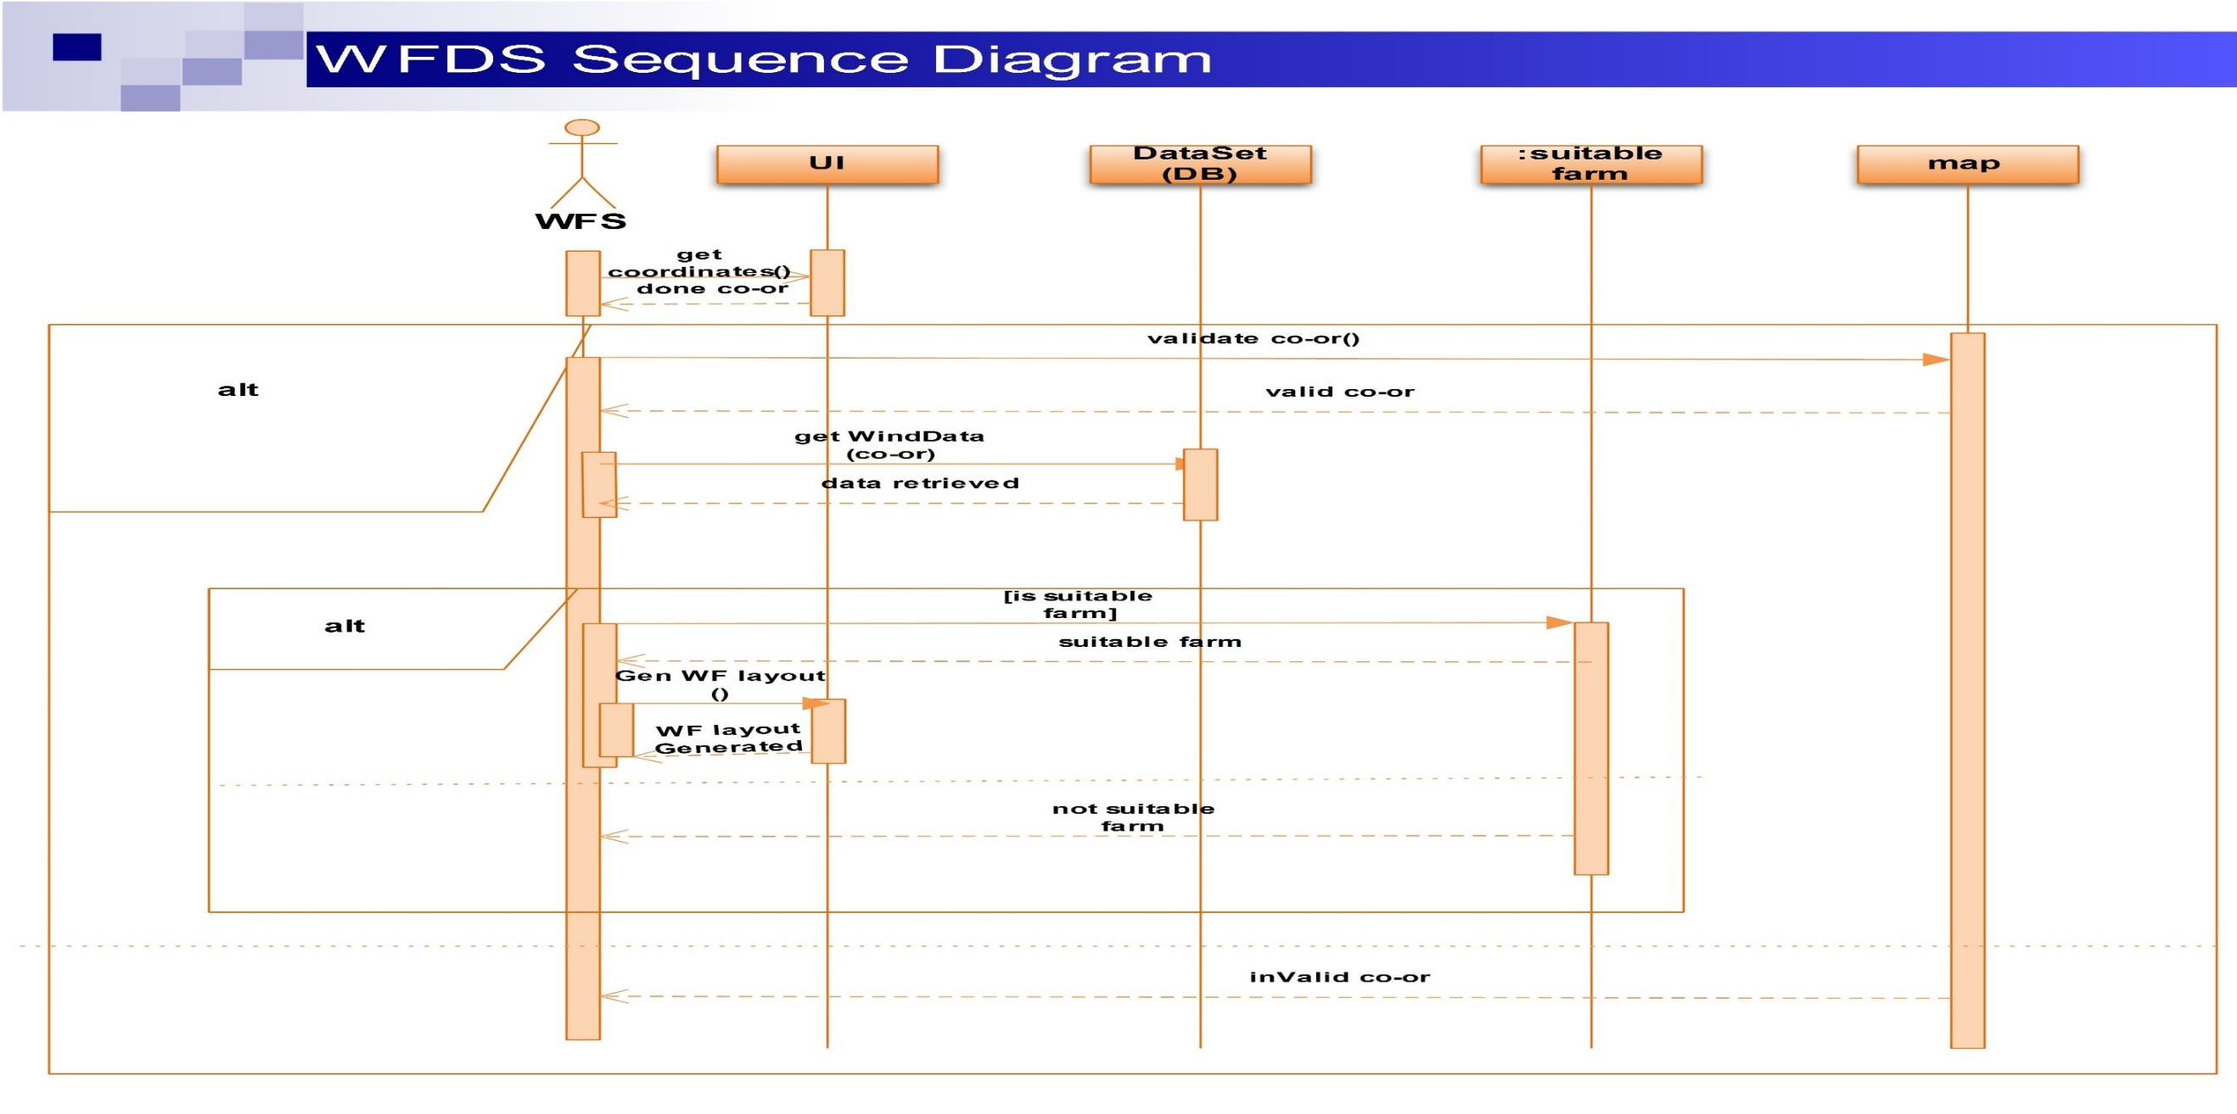
Wind Farms Design Sequence Diagram

Slide 12



Software & Hardware Tools.
Software
ODBC -> database source
map within GPS
hardware
Processor, Memory , Graphics and Screen Resolution ,Disk space , ports (computer)

Slide 13
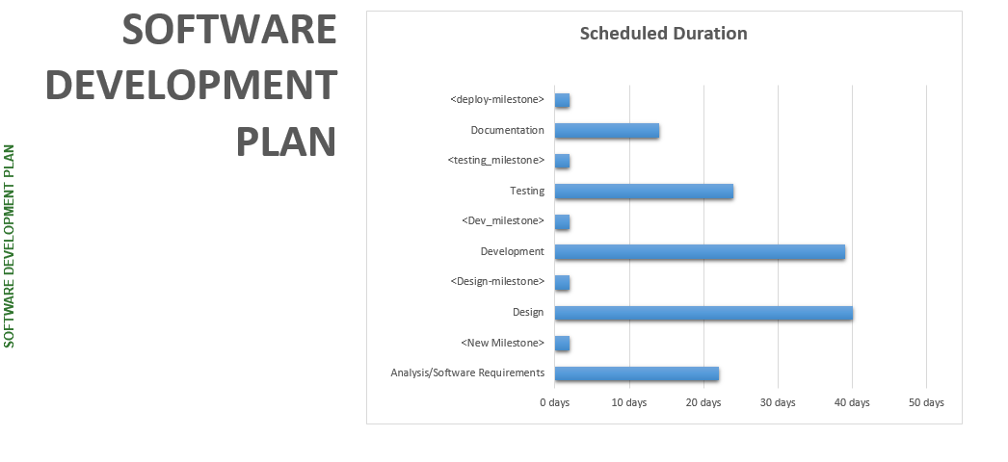
Time plan

Slide 14
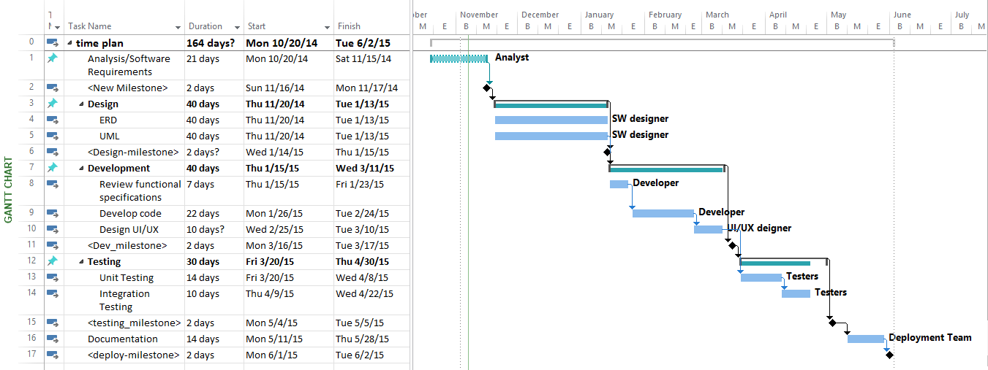
Get focus …

